Slide 1







Dept. of Communication Engineering College of Engineering- University of Diyala Lecture No.: 2
3rd year Class
Antenna Theory and Design Lec. Jinan N. Shehab
1- The Uniform Plane Waves:-
In this chapter we shall apply Maxwell's equation to introduce the fundamental theory of wave motion.
1-1 The wave equation:-
the effect of propagation of EM wave in medium: Free space; Lossy dielectric; Lossless dielectric (perfect dielectric) and Conducting media. These propagation phenomena for a type traveling wave called plane wave can be explained or derived by Maxwell’s equations.
Assume that EM field exists in a homogenous linear medium with parameter 𝜀. � & 𝜎.
From Maxwell’s equations:
∇× E = -
∂B
= -μ
∂H
(1)
∂t
∂t
∇× H = J +
∇• D = ρ_{v}
∇• B = 0
∂D
= J + ε
∂E
(2)
∂t
∂t
(3)
(4)
To eliminate H from the eq.(1) , let us apply the curl operator to the eq.(1):-
(5)
(6)
So eq.(5) & (6) become:-
(7)
(8)

Slide 2
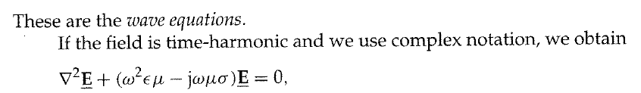

Dept. of Communication Engineering College of Engineering- University of Diyala Lecture No.: 2
3rd year Class
Antenna Theory and Design Lec. Jinan N. Shehab
Where:-
_{γ} 2
= jωμ (σ + jωε )
= -ω ² με + jωμσ
γ = propagation constant γ = α + jβ
γ ² = (α ² - β ² )+ 2 jαβ
�² − �² = −𝜔²��
& 2�� = 𝜔�𝜎
α: - is known as attenuation constant as a measure of the wave is attenuated while traveling in a medium.
β : - is phase constant
β = ω
με ⎡
_{σ} 2
⎤
+ 1⎥
⎥⎦
rad / m
με ⎡
_{σ} 2
⎤
- 1⎥ Np / m
⎢ 1 +
2 ⎢⎣
_{ω} 2_{ε} 2
α = ω ⎢ 1 +
_{ω} 2_{ε} 2
2 ⎢
⎥
⎣
⎦
𝜔
Wave velocity �_{𝑝}= _{𝛽}
1-2 Plane Wave In Lossless (Perfect) Dielectrics: -
Parameters: -
σ = 0,ε = ε₀ε _{r} , μ = μ₀ μ_{r}
α = 0, β = ω με
v = u = ^{ω} =
β
1 _{λ =} 2π
β
με
,
1-3 Plane Wave In Free Space: -
Free space is nothing more than the perfect dielectric media:

Slide 3




Dept. of Communication Engineering College of Engineering- University of Diyala Lecture No.: 2
3rd year Class
Antenna Theory and Design Lec. Jinan N. Shehab
α = 0 ,
β = ω μ₀ε₀ = ω / c
u = ^{ω} =
β
1
= c ,
_{λ =} 2π
β
μ₀ε₀
u = c ≈ 3×10⁸ m / s
2- Radio Channel
Signal transmission in a radio system is based on converting the electrical signals generated by the transmitter into electromagnetic waves, propagation of waves in space and conversion back into electrical signals at the receiver side of the system.
The channel is a medium through which the transmitter output is sent. The physical medium between antennas where electromagnetic waves are propagated is called the propagation channel. Wireless communications systems exploit the air as a transmission medium. Obstacles such as buildings, hills and mountains influencing the propagation of electromagnetic waves, are considered to be part of the propagation channel. Hence, the propagation path from a radio transmitter antenna to a receiver antenna is called the radio propagation channel.
The propagation channel, together with the antennas, constitutes the radio channel as shown in Figure (1). The communication channel is described in terms of the bandwidth which determining the maximum information rate of the channel. The channel can introduce various kinds of distortion and delay into the signal as we will see later.
Propagation Channel
Antennas Radio Channel
Figure (1) Radio and Propagation Channels
Tx
Rx
Advantages of the radio system include:
1- Operate over large distances. 2- Decrease the installation costs.
Be installed faster than other communication mediums.
Be easily re-installed in new locations as when plants are relocated.
Enable the user (subscriber) to transmit any information in any format that he requires.

Slide 4
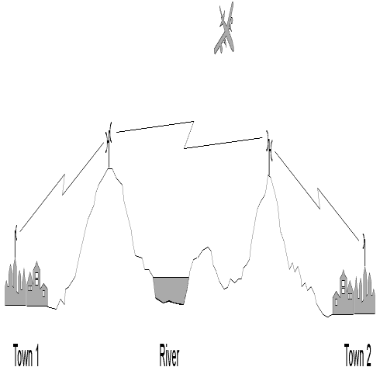
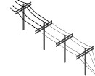
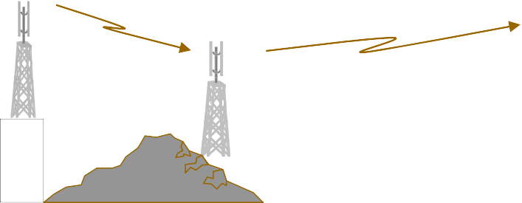


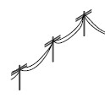







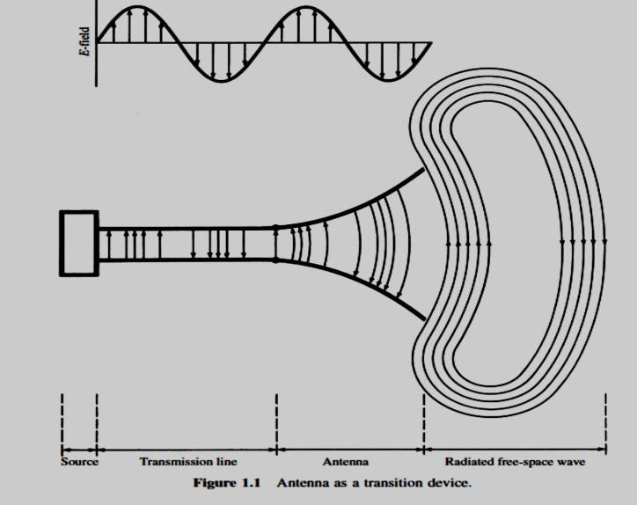
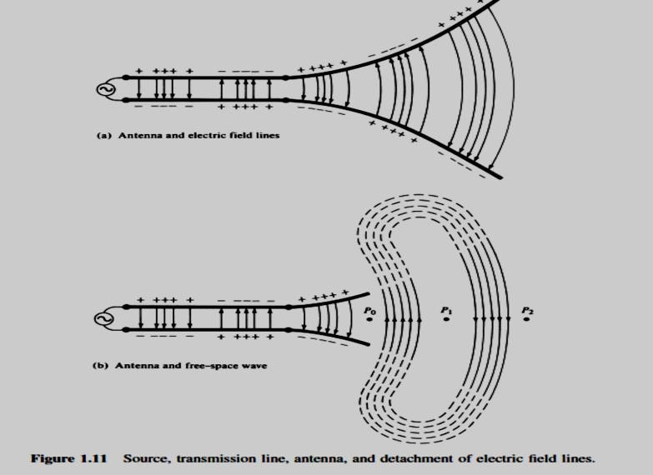
Dept. of Communication Engineering College of Engineering- University of Diyala Lecture No.: 2
3rd year Class
Antenna Theory and Design Lec. Jinan N. Shehab
Span lakes or rivers, where a cable facility would require special treatment to prevent water seepage onto the copper conductors, as shown in Figure 1
Overcome transmission obstacles such as mountains and deep valleys, where cable installation cost is too high and difficult to maintain.
Bypass the basic interconnection to the local telephone provider as shown in Figure 2.
Wireless communication is being seen as an alternative to quickly and cost effectively meeting the need for flexible l
inks.
Radio link
Radio link
3- Antennas
River
3-1 Fundamental parameters of Antennas: -
An antenna is an electrical conductor or system of conductors:
Transmission – radiates EM energy into space. Reception – collects EM energy from space.
In two ways communication, the same antenna can be used for transmission and
reception.
An antenna is a circuit element that provides transition form a guided wave on transmission line to free space wave and it provides for collection EM energy.
In transmit system the RF signal is generated, amplified, modulated and applied to the
antenna.
In receive system the antenna collects EM waves.

Slide 5
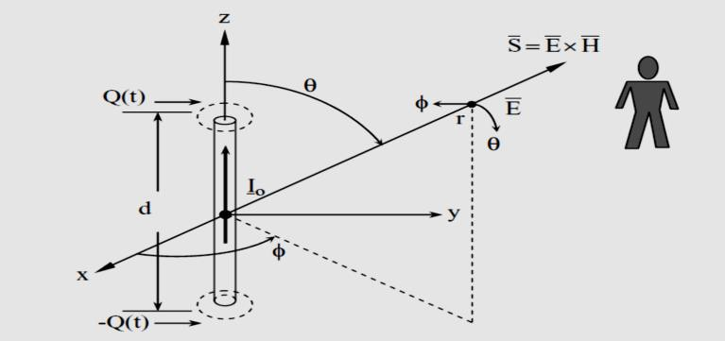



Dept. of Communication Engineering College of Engineering- University of Diyala Lecture No.: 2
3rd year Class
Antenna Theory and Design Lec. Jinan N. Shehab
3-2 The ideal dipole: -
The simplest infinitesimal radiating element, called a Hertzian dipole, is a current element of length dl carrying I(t) amperes. Conservation of charge requires charge reservoirs at each end of the current element containing ±q(t) coulombs, where I = dq/dt. The total charge is zero.
Analysis of the Radiative Field
(other terms used for ideal dipole are Hertzian electric dipole, infinitesimal dipole, and doublet).
electric
dipole,
Very small finite length (dl << λ ).
Assume an element of current of length dl along z- axis.
dl centered on the coordinate origin.
Constant uniform amplitude current I.
Figure (1): An elementary doublet.
3-2-1 Magnetic potential at a distance r from this current element is
The current in the doublet oscillatory with frequency 𝜔= 2𝜋�
The current is said to be retarded at point P because there is a propagation time delay r/c or phase delay βr from 0 to P, so that we may write:-

Slide 6
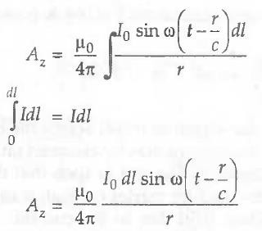
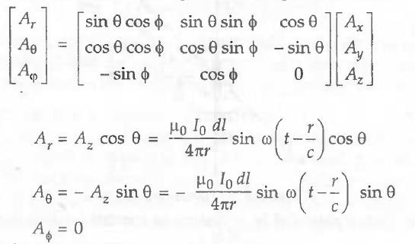
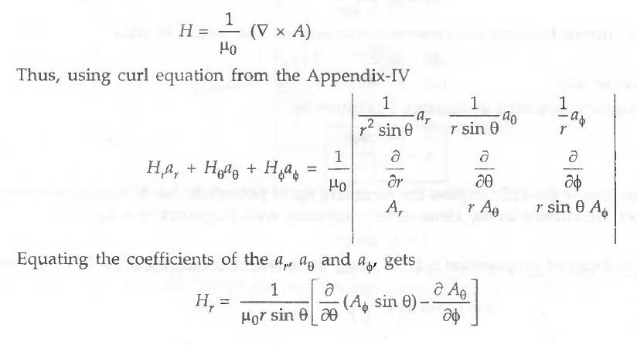
Dept. of Communication Engineering College of Engineering- University of Diyala Lecture No.: 2
3rd year Class
Antenna Theory and Design Lec. Jinan N. Shehab
Referring to figure above, current element dl is symmetrically placed about the origin with its axis along the z axis, the current on the element has only a z-component, A also has only the Az component. Thus, the magnetic potential at P is
Referring to figure (1) again, it is clear that A has only z-component and
Ax = Ay = 0.
Using the transformation between rectangular and spherical components is:
3-2-2 The magnetic field intensity H can be expressed as:-

Slide 7
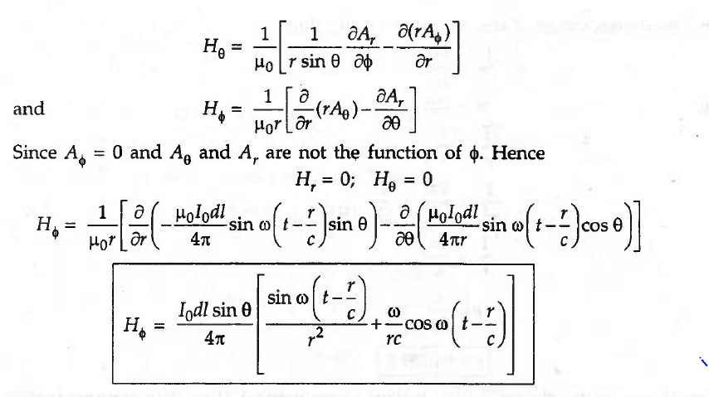
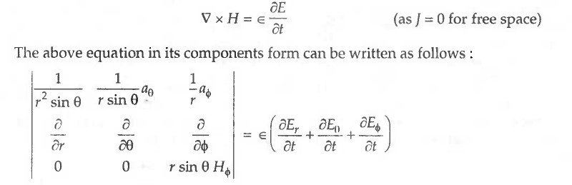
Dept. of Communication Engineering College of Engineering- University of Diyala Lecture No.: 2
3rd year Class
Antenna Theory and Design Lec. Jinan N. Shehab
There are two parts of which:
1) ¹ sin ω (t − ^{r}⁄ ) : Which represent the induction field.
�2
c
𝟐) ^{𝜔}���𝜔(� − �⁄�) : Represents the radiative field which is available at the point r. It is a
��
progressive waveform and is the electromagnetic energy propagated in space. We generally
take only this term into account for radiation.
3-2-3 The electric field E can be obtaining from magnetic field i H by applying Maxwell's first equation for free space:

Slide 8
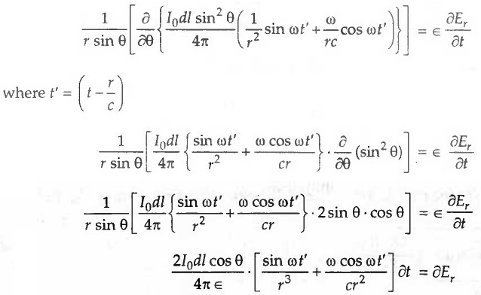
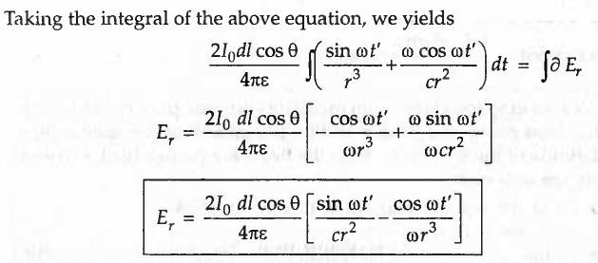
Dept. of Communication Engineering College of Engineering- University of Diyala Lecture No.: 2
3rd year Class
Antenna Theory and Design Lec. Jinan N. Shehab
The electric field strength from a current element along the radial direction for r
>> λ is negligible because varying as a function of 1/r² and 1/r³. Hence substituting H in equation (1.11) and performing similar operation as before, we obtain: -

Slide 9
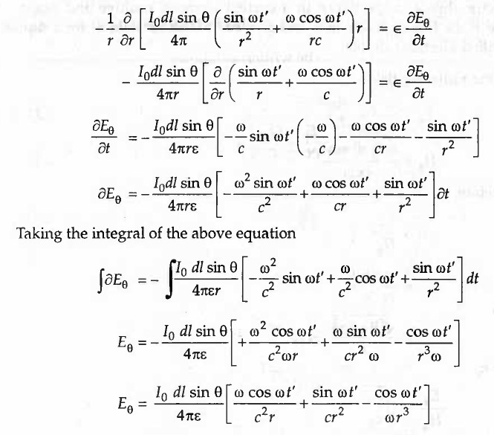


Dept. of Communication Engineering College of Engineering- University of Diyala Lecture No.: 2
3rd year Class
Antenna Theory and Design Lec. Jinan N. Shehab
The inverse distance (1/r) first, term is the radiating field for r » λ. Thus,
The equations by using phase delay βr from 0 to P:
� ∆ � �� 1
�∅ = _{4𝜋}( � + _{�2}) �
−𝑗𝛽�
sin �

Slide 10
Dept. of Communication Engineering College of Engineering- University of Diyala Lecture No.: 2
3rd year Class
Antenna Theory and Design Lec. Jinan N. Shehab
_{𝐸=} 𝐼∆𝑧[ 𝑗�� _{+ √}� 1 ₊ 1
] �^{−𝑗𝛽�} sin � �̂ + ^{𝐼∆𝑧}[ √�
1 ₊ 1
] �^{−𝑗𝛽�} �����̂
4𝜋�
𝜀�² 𝑗���³ 2𝜋𝜀�² 𝑗���³
Note that if the medium surrounding the dipole is air or free space, β=�√�₀𝜀₀ can be written as:-
��� 1
� = _{4𝜋}�� (1 + ���)
�−𝑗𝛽�
sin � ∅̂
�
𝐸= ^{𝐼�𝑙}��� [ 1 +
1 1 ] �
−𝑗𝛽𝑟
4𝜋
+
sin � �̂ + ^{𝐼�𝑙}� [ ¹ − � ¹ ] �^{−𝑗𝛽�} �����̂
𝑗𝛽� (𝑗��)² �
2𝜋� 𝛽2
Radiation field term
Static field(quasi-stationary)
Induction field term
• For � < � , �ℎ� ������ ����� �� �������� (������ ���� ����� �� �ℎ� ℎ������� ������)
2𝜋
�
• For � > , �ℎ� ��������� ����� �� ��������(��� �����).
2𝜋
�
• For � = , �ℎ� ��������� ����� �� ��������(𝑁��� �����).
2𝜋
If βr >> 1, far-field boundary condition, then Radiation field:-
���
�∅ = _{4𝜋}��
�−𝑗𝛽�
sin � ∅̂
�
���
𝐸_{𝜃}= _{4𝜋}���
�−𝑗𝛽�
sin � �̂
�
More specifically, we define the boundary between the near and the far zones by the value of r given by
2
_{� =} 2�
�
where d is the largest dimension of the antenna.
So, a current element located in space, carrying an oscillatory current gives rise to two radiating field Eθ and HØ the electric field being along the meridian (longitude) of the sphere
and the magnetic field along the latitude of the sphere (Ø). Both the fields are perpendicular to each other. By these, following results are obtained:
  The field is maximum at the equator and equal to zero at poles.

Slide 11
Dept. of Communication Engineering College of Engineering- University of Diyala Lecture No.: 2
3rd year Class
Antenna Theory and Design Lec. Jinan N. Shehab
The field intensities increase with frequency.
Both the fields are in time phase indicating transfer of energy. Impedance is the ratio of the (Eθ) to magnetic (Hɸ) :-
𝐸_{𝜃}�� �� �
� = � =
�
= = √
� ��𝜀
∅
√
�₀ = 120𝜋𝛺= 376.7 𝛺��� ���� ����� �� �₀ = 4𝜋× 10⁻⁷& 𝜀₀ = 8.854 × 10⁻¹²
So, the radiating wave has the same impedance as the free space impedance of 120 𝜋ohms and hence the radiating field is matched into the free space impedance
for maximum transfer of power.
3-2-4 Power radiated by a current element: -
The time-average power density:-
1 1
∗
�_{𝑎��} = ₂ 𝑅�(𝐸� × ��) = ₂ 𝑅�(𝐸_{𝜃�}�∅��)
This is the power radiated by the current element along the radius vector r of the sphere and is perpendicular to (𝜑) and (�). The total power radiated is obtained by taking the surface integral of over any surface enclosing the current element as:-
1 ��� ₂
−𝑗𝛽� −𝑗𝛽�
�_{�𝑎�} = ∫ �_{𝑎��} . �� = ₂ (_{4𝜋}) ∫ ���
�
�
sin � �̂ × −��
�
�
sin � ∅̂
Then �� = �² sin � �� �∅ �̂ �ℎ��
�̂ × ∅̂ = �̂
2𝜋𝜋
�_{�𝑎�} = ₂ (_{4𝜋}) ��� ∫ ∫
0
2
1 ��� ₂
��� �
�2
2
� sin � �� �∅
0
1 ��� ₂ ₂ ��� ₂
4 ���
= ₂ (_{4𝜋}) ��� (2𝜋) ₃ = _{12𝜋}(���) = 40 𝜋( � )
3-2-5 the radiation resistance:-
the power radiated from an ideal dipole of length dl <<λ and input current I is:-
1
�_{�𝑎�} = ₂ 𝑅� |�|
2
1
���� �ℎ�� � ������ �� ������� ������� ������� � �� �ℎ� ���� ����� �� �ℎ�
2
���� ��������

Slide 12
Dept. of Communication Engineering College of Engineering- University of Diyala Lecture No.: 2
3rd year Class
Antenna Theory and Design Lec. Jinan N. Shehab
𝜔�� 1
2 2
�_{�𝑎�} = _{12𝜋}(���) = ₂ 𝑅� |�|
Then for ideal dipole
9 ^{𝜔�𝛽}(��)² = 𝑅= 80𝜋²(��)²𝛺
�
12𝜋�

